Slide 1


KERNEL
Notes:
O Logo de espadas deve ter mais espaço das pontas abaixo. Sugerir outros tipos de imagens/ telefone, fones.

Slide 2
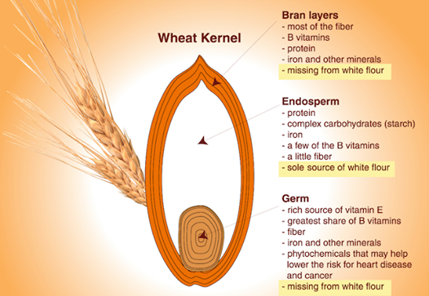

Literal Definition
A softer, usually edible part of a nut, seed, or fruit stone contained within its shell.
The central or most important part of something. “This is the kernel of the argument”.

Slide 3
Formal Definition
A kernel is the foundational layer of an operating system (OS).
It functions at a basic level, communicating with hardware and managing resources, such as RAM and the CPU.
It is the part of the operating system that loads first, and it remains in main memory. Because it stays in memory, it is important for the kernel to be as small as possible while still providing all the essential services required by other parts of the operating system and applications.

Slide 4
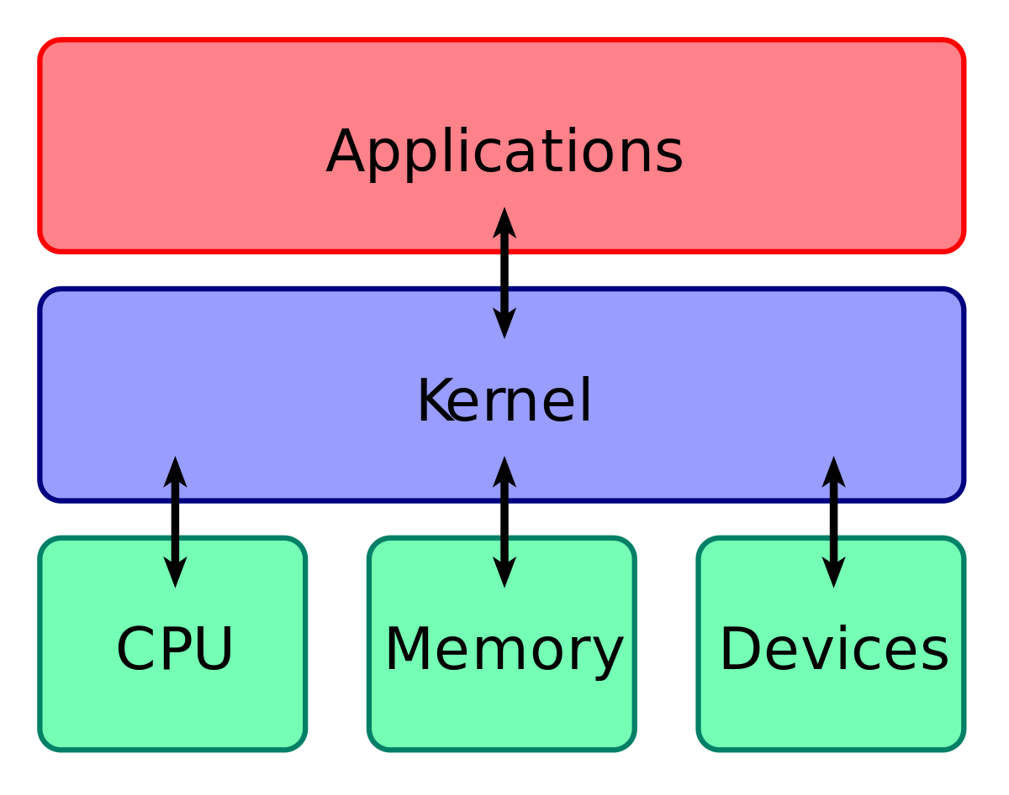
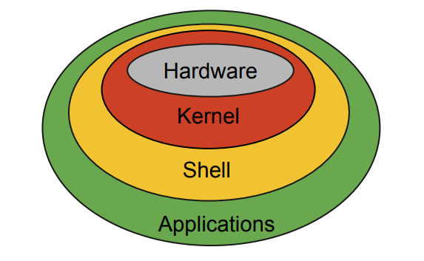
BASIC STRUCTURE

Slide 5
Basic Facilities : CPU
This central component of a computer system is responsible for running or executing programs. Often multiple programs will want access to memory, frequently demanding more memory than the computer has available.
The kernel is responsible for deciding which memory each process can use, and determining what to do when not enough memory is available.
RESOURCE
MANAGEMENT

Slide 6
Basic Facilities : Memory (RAM)
RAM is used to store both program instructions and data. Typically, both need to be present in memory in order for a program to execute.
The kernel takes responsibility for deciding at any time which of the many running programs should be allocated to the processor or processors.
MEMORY
MANAGEMENT

Slide 7
Basic Facilities : Devices
I/O devices include such peripherals as keyboards, mice, disk drives, printers, USB devices, network adapters, and display devices.
The kernel allocates requests from applications to perform I/O to an appropriate device and provides convenient methods for using the device (typically abstracted to the point where the application does not need to know implementation details of the device).
DEVICE
MANAGEMENT

Slide 8
TYPES OF KERNEL
Monolithic Kernel
User services and kernel, services are kept in same address space.
Slow execution.
Monolithic kernel is larger than microkernel.
If a service crashes, the whole system crashes in monolithic kernel.
To write a monolithic kernel, less code is required.
Micro Kernel
User services and kernel, services are kept in separate address space.
Fast execution.
Microkernel are smaller in size.
If a service crashes, it does effect on working of microkernel.
To write a microkernel, more code is required.
Notes:
Fixar a posicao do titulo – sempre do lado esquerdo.
Sempre que tiver muito texto o coluna deve sempre ser “ narrowed” , se nao fica dificil de ler. Colocar paragrafos no texto.
Linha vertical deve ser mais fina e as pontas NUNCA devem ser arredondadas.

Slide 9
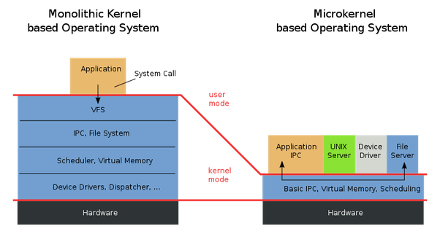
User Space – Space in memory where user applications are executed.
Kernel Space – Space in memory where
kernel processes run. The user has access to it only through system calls

Slide 10
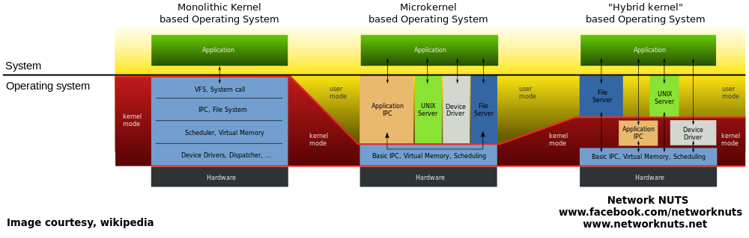

Slide 11
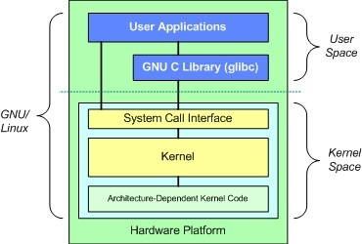
LINUX KERNEL
Linux kernel is a monolithic kernel
USER SPACE COMPONENTS :
User applications
glibc : Provides the system call interface that connects to the kernel : transition mechanism between user-space and kernel.
Each user space process occupies its own virtual address space (vs the kernel which runs on the single address space)

Slide 12
KERNEL SPACE COMPONENTS :
System Call Interface : provides the basic functions such as read() and write().
Kernel
Architecture-independent kernel code.
Common to all processor architectures supported by Linux.
Architecture-Dependent Code
Processor and platform specific code.
Also k/a Board Support Package

Slide 13
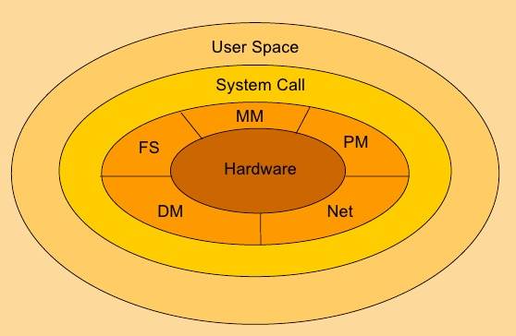
Kernel Subsystems
PS (or SCHED) – Process Scheduler
MM – Memory Manager
VFS – Virtual File System
DM – Device Manager
NET – Network Interface
IPC (System Call) – Inter Process Communication subsystem.
V
S

Slide 14
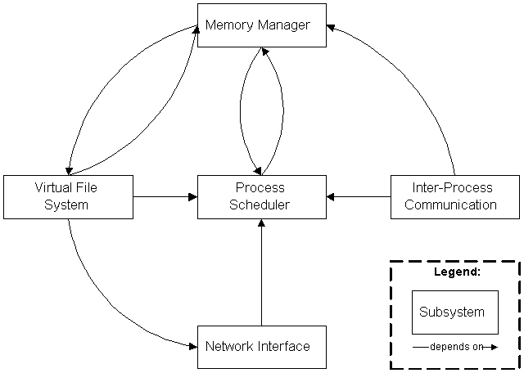
The Inter-Process Communication (IPC) subsystem supports several mechanisms for process-to-process communication on a single Linux system.

Slide 15
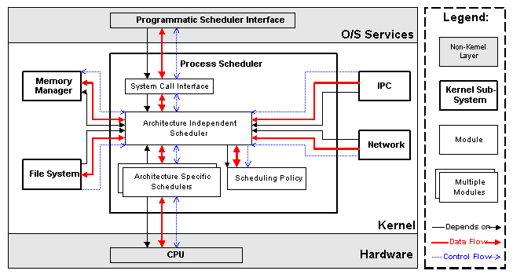
Process Scheduler (SCHED)
The Process Scheduler
(SCHED) is responsible for controlling process access to the CPU. The scheduler enforces a policy that ensures that processes will have fair access to the CPU, while ensuring that necessary hardware actions are performed by the kernel on time.

Slide 16
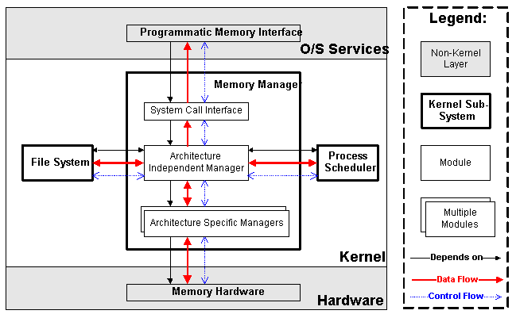
Memory Manager (MM)
The Memory Manager (MM) permits multiple process to securely share the machine's main memory system. In addition, the memory manager supports virtual memory that allows Linux to support processes that use more memory than is available in the system. Unused memory is swapped out to persistent storage using the file system then swapped back in when it is needed.

Slide 17
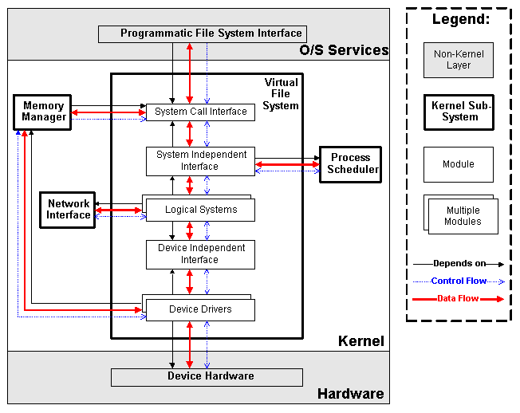
Virtual File System (VFS)
The Virtual File System (VFS) abstracts the details of the variety of hardware devices by presenting a common file interface to all devices. In addition, the VFS supports several file system formats that are compatible with other operating systems.

Slide 18
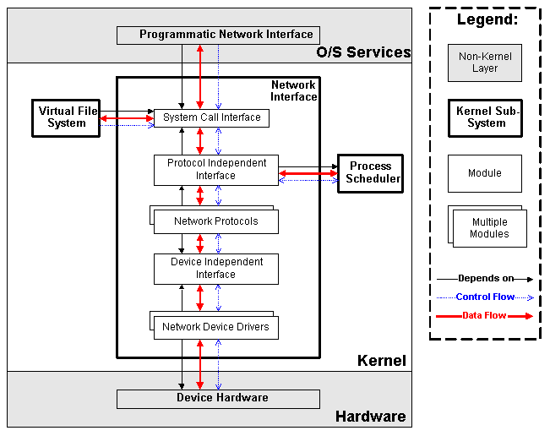
Network Interface (NET)
The Network Interface (NET) provides access to several networking standards and a variety of network hardware.

Slide 19
BOOTING
PROCESS
Notes:
O Logo de espadas deve ter mais espaço das pontas abaixo. Sugerir outros tipos de imagens/ telefone, fones.

Slide 20
LINUX BOOTING PROCESS
BIOS
System Startup/Hardware initialization
MBR
Boot loader Stage 1
GRUB
Boot loader Stage 2
Kernel
Linux OS (executes /sbin/init)
INIT
User Space Ready (starts Run Level)
RunLevel
Start scripts in dir /etc/rc.d/rc*.d/

Slide 21
1. BIOS
BIOS stands for Basic Input/Output System
Performs some system integrity checks
Searches, loads, and executes the boot loader program.
It looks for boot loader in floppy, cd-rom, or hard drive. You can press a key (typically F12 of F2, but it depends on your system) during the BIOS startup to change the boot sequence.
Once the boot loader program is detected and loaded into the memory, BIOS gives the control to it.
So, in simple terms BIOS loads and executes the MBR boot loader.

Slide 22
2. MBR
MBR stands for Master Boot Record.
It is located in the 1st sector of the bootable disk. Typically /dev/hda, or /dev/sda
MBR is less than 512 bytes in size. This has three components
1) primary boot loader info in 1st 446 bytes
2) partition table info in next 64 bytes
3) mbr validation check in last 2 bytes.
It contains information about GRUB (or LILO in old systems).
So, in simple terms MBR loads and executes the GRUB boot loader.

Slide 23
3. GRUB
GRUB stands for Grand Unified Bootloader.
If you have multiple kernel images installed on your system, you can choose which one to be executed.
GRUB displays a splash screen, waits for few seconds, if you don’t enter anything, it loads the default kernel image as specified in the grub configuration file.
GRUB has the knowledge of the filesystem (the older Linux loader LILO didn’t understand filesystem).
Grub configuration file is /boot/grub/grub.conf (/etc/grub.conf is a link to this).

Slide 24
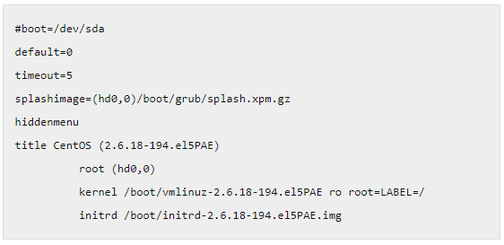
sample grub.conf of CentOS.
As you notice from the above info, it contains kernel and initrd image.
So, in simple terms GRUB just loads and executes Kernel and initrd images

Slide 25
4. Kernel
Mounts the root file system as specified in the “root=” in grub.conf
Kernel executes the /sbin/init program
Since init was the 1st program to be executed by Linux Kernel, it has the process id (PID) of 1. Do a ‘ps -ef | grep init’ and check the pid.
initrd stands for Initial RAM Disk.
initrd is used by kernel as temporary root file system until kernel is booted and the real root file system is mounted. It also contains necessary drivers compiled inside, which helps it to access the hard drive partitions, and other hardware.

Slide 26
5. INIT
Looks at the /etc/inittab file to decide the Linux run level.
Following are the available run levels :
0 – halt
1 – Single user mode
2 – Multiuser, without NFS
3 – Full multiuser mode
4 – unused
5 – X11
6 – reboot

Slide 27
5. INIT
Init identifies the default initlevel from /etc/inittab and uses that to load all appropriate program.
Execute ‘grep initdefault /etc/inittab’ on your system to identify the default run level
If you want to get into trouble, you can set the default run level to 0 or 6. Since you know what 0 and 6 means, probably you might not do that.
Typically you would set the default run level to either 3 or 5.

Slide 28
6. Runlevel Programs
When the Linux system is booting up, you might see various services getting started. For example, it might say “starting sendmail …. OK”. Those are the runlevel programs, executed from the run level directory as defined by your run level.
Depending on your default init level setting, the system will execute the programs from one of the following directories.
Run level 0 – /etc/rc.d/rc0.d/
Run level 1 – /etc/rc.d/rc1.d/
Run level 2 – /etc/rc.d/rc2.d/
Run level 3 – /etc/rc.d/rc3.d/
Run level 4 – /etc/rc.d/rc4.d/
Run level 5 – /etc/rc.d/rc5.d/
Run level 6 – /etc/rc.d/rc6.d/

Slide 29
6. Runlevel Programs
Under the /etc/rc.d/rc*.d/ directories, you would see programs that start with S and K.
Programs starts with S are used during startup. S for startup.
Programs starts with K are used during shutdown. K for kill.
Numbers right next to S and K in the program names : sequence number in which the programs should be started or killed.
S12syslog : start the syslog deamon, which has the sequence number of 12.
S80sendmail is to start the sendmail daemon, which has the sequence number of 80.
(So, syslog program will be started before sendmail)

Slide 30
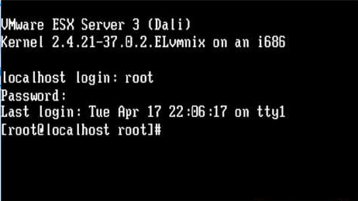
Final step : LOGIN

